Slide 1
IoT Protocols https://www.youtube.com/watch?v=l-oY-ePIdRs https://www.youtube.com/watch?v=QXV_HgGO--g https://www.youtube.com/watch?v=NSkIHdV6NoY

Slide 2
Bluetooth, Zigbee, WiFi

Slide 3
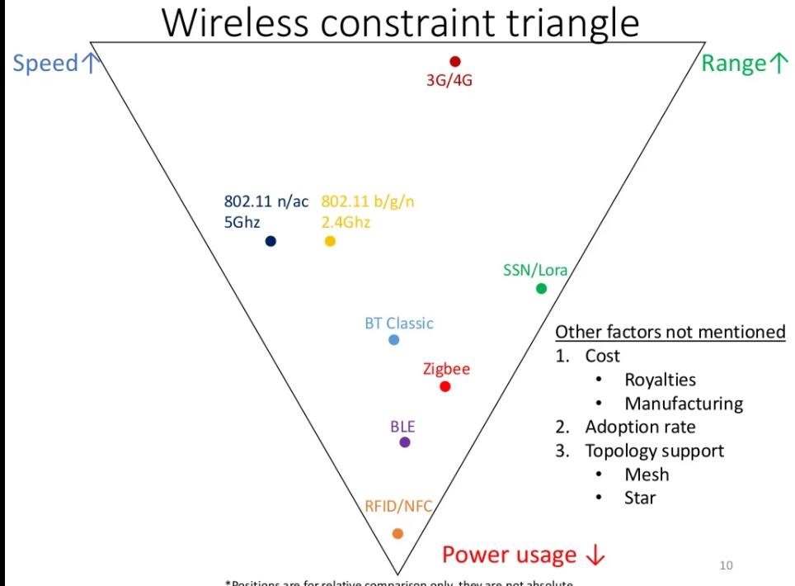

Slide 4
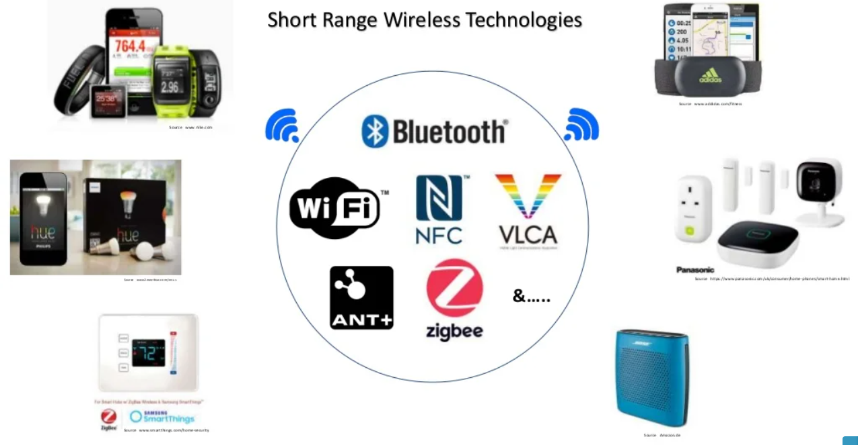

Slide 5
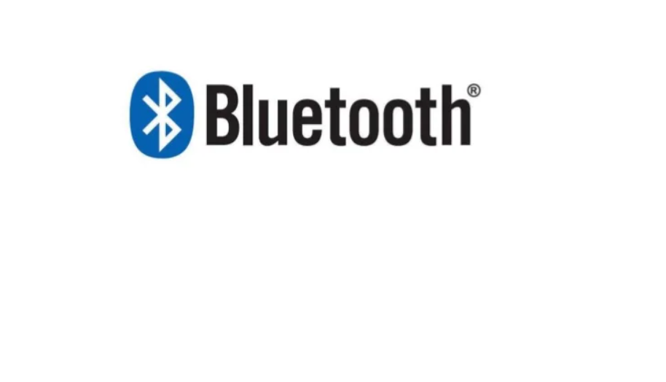

Slide 6
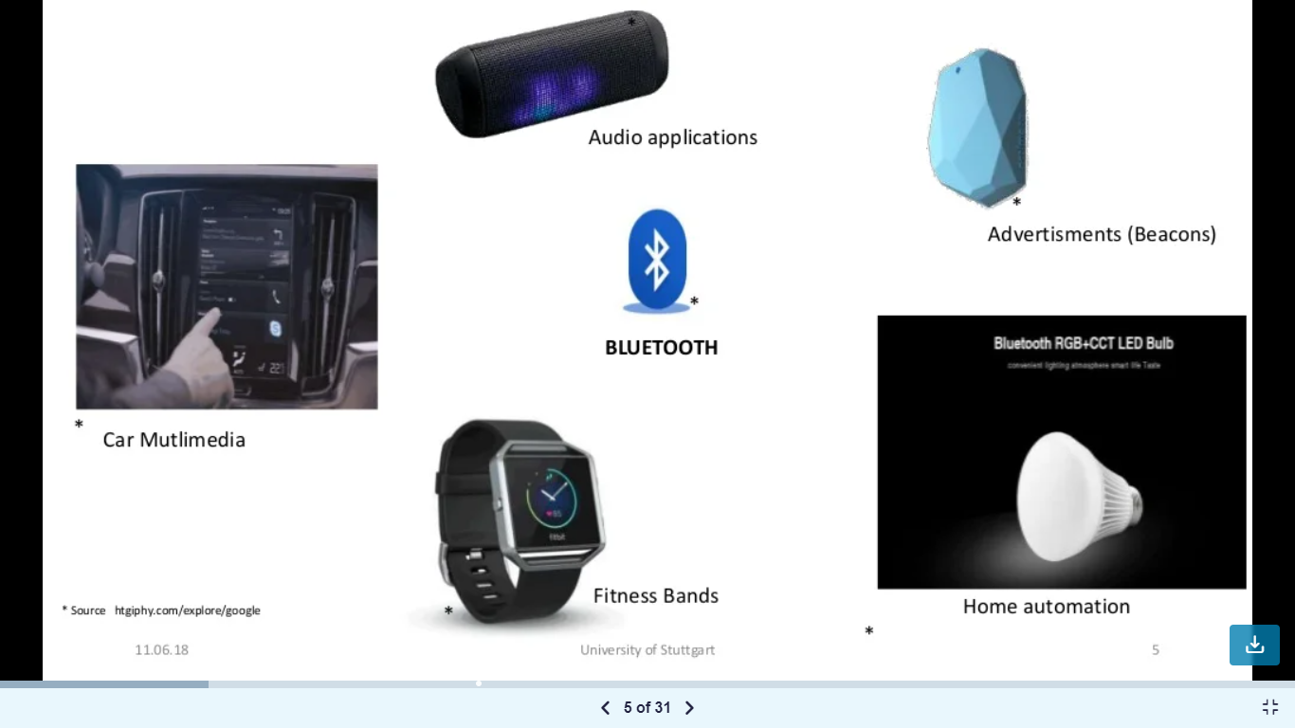

Slide 7
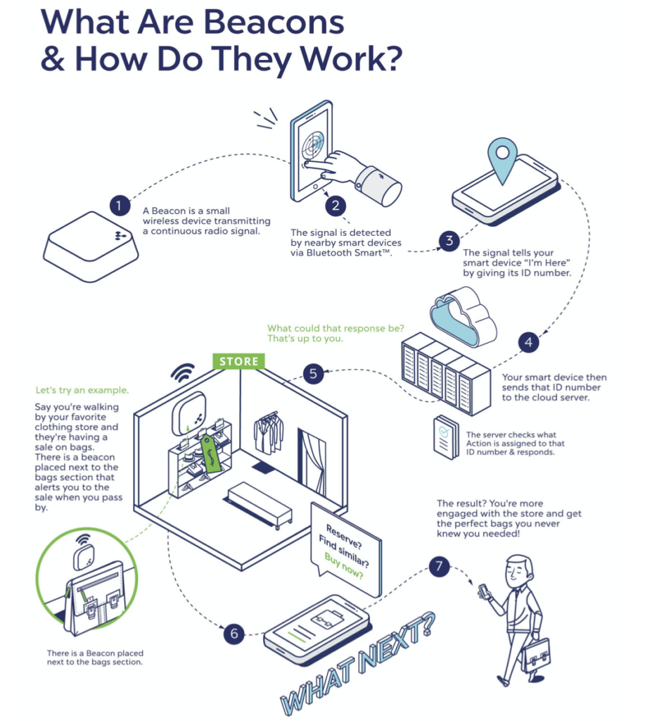

Slide 8
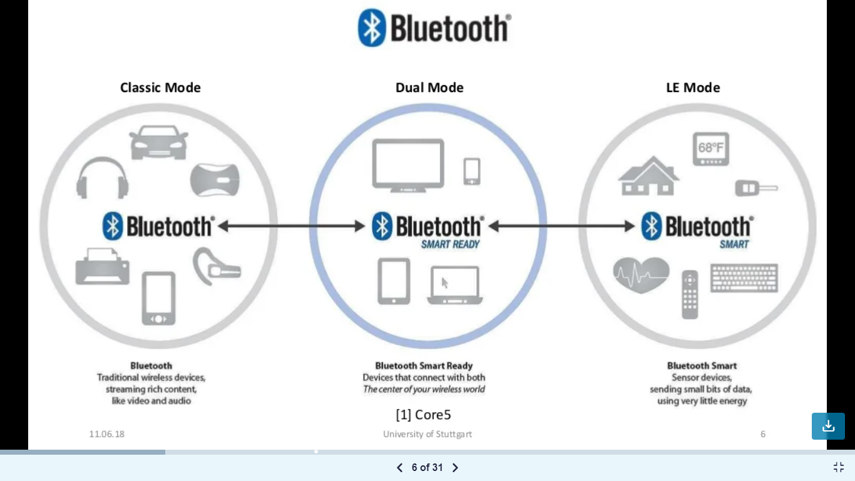

Slide 9
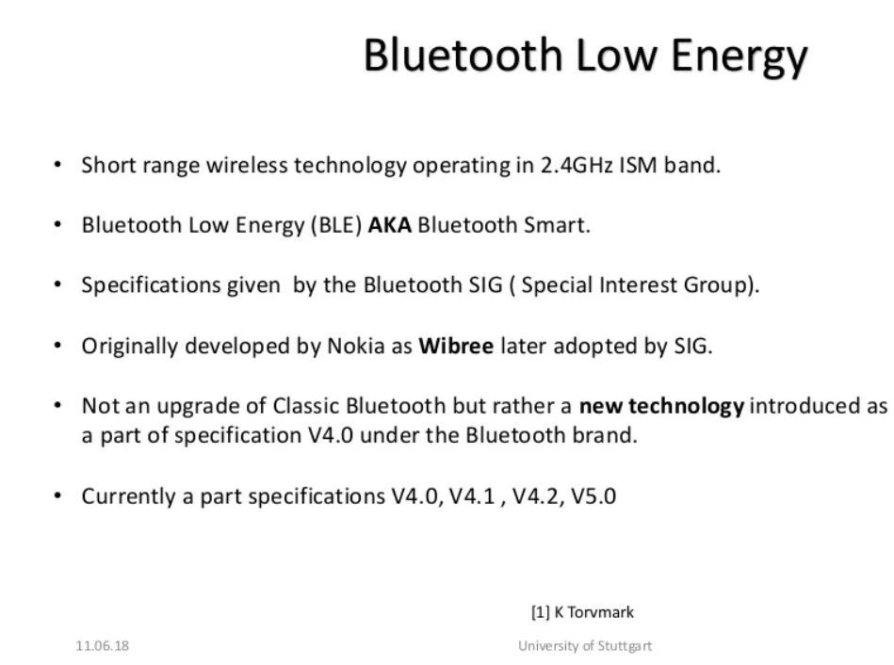

Slide 10
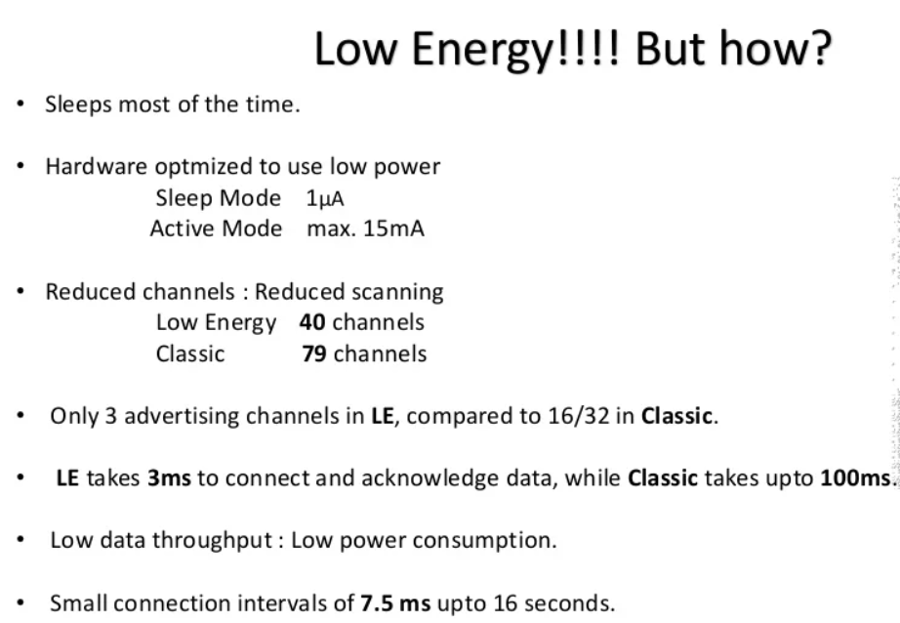

Slide 11
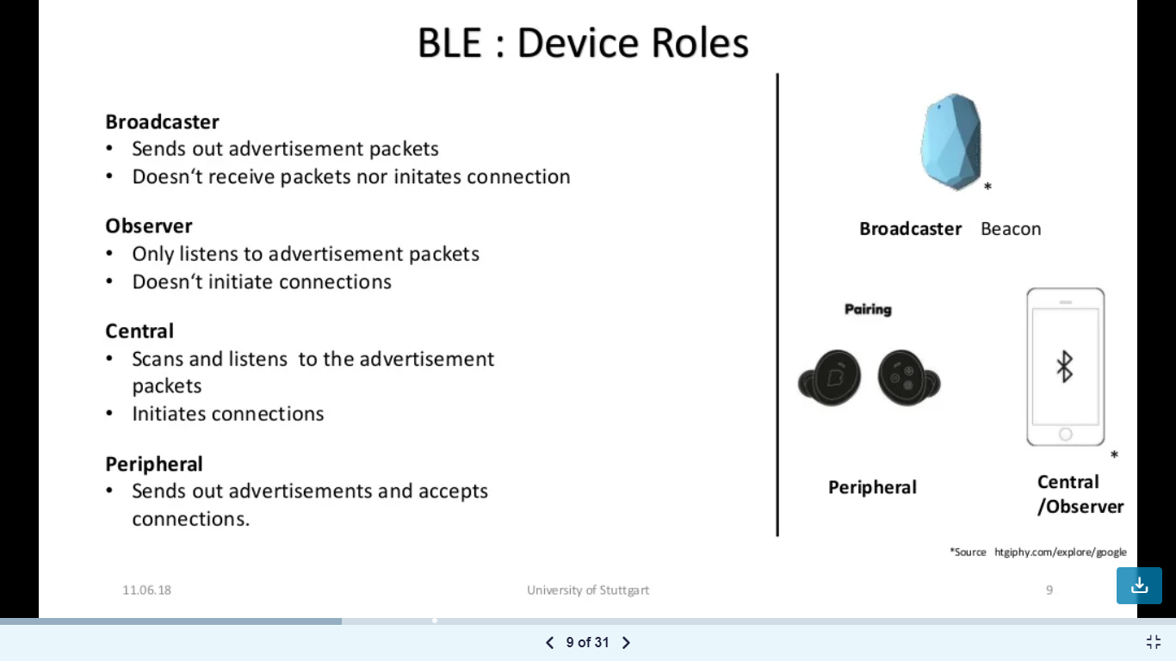

Slide 12
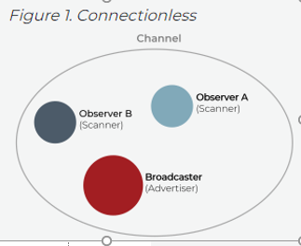
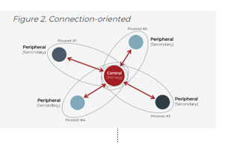

Slide 13
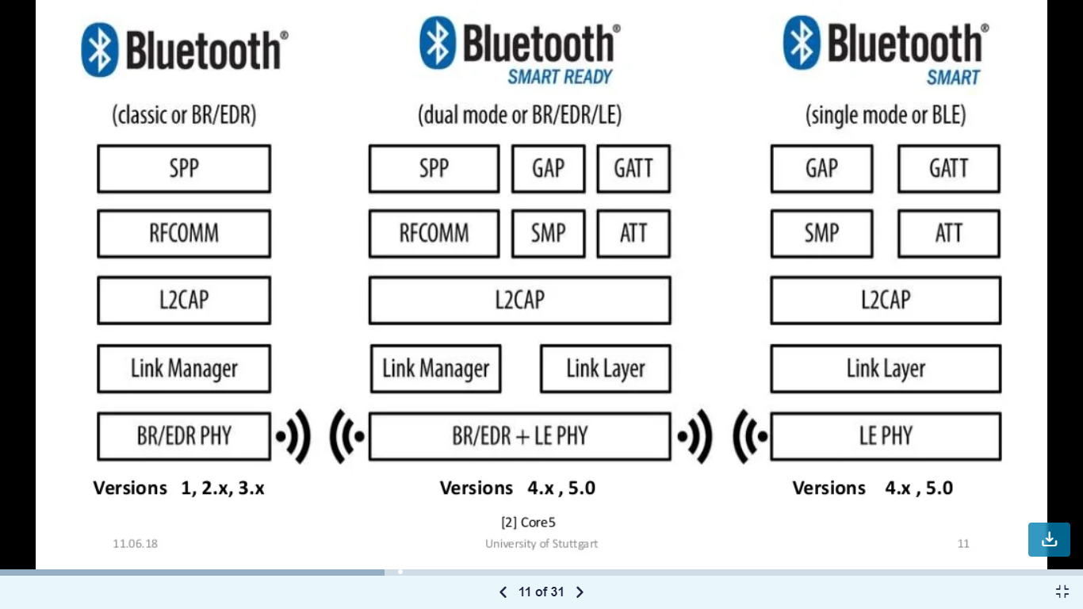

Slide 14
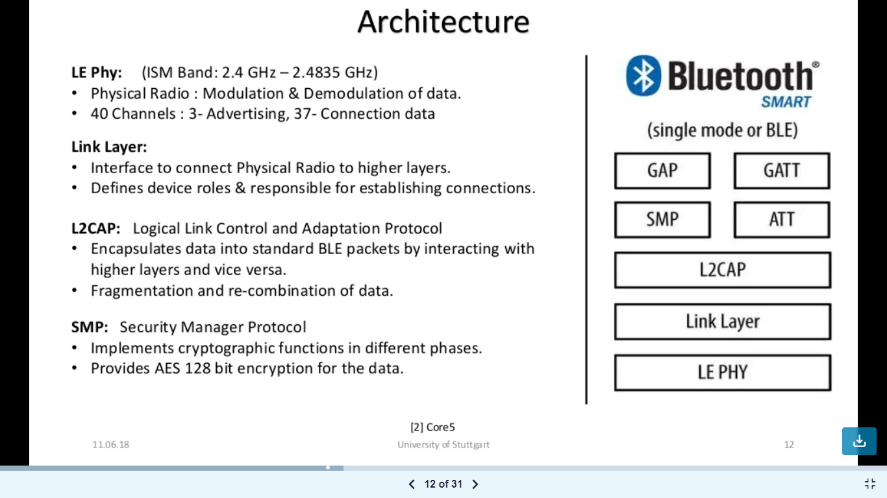

Slide 15
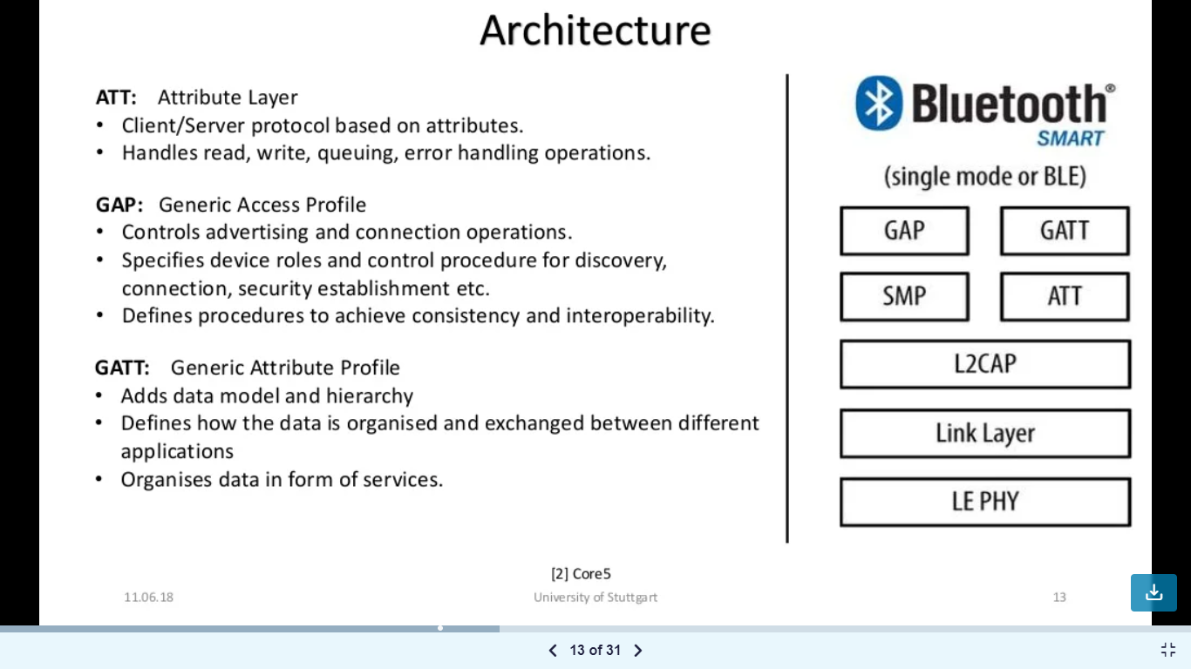

Slide 16
Zigbee

Slide 17
ZigBee
IEEE 802.15.4-based specification for a suite of high-level communication protocols
Used to create personal area networks with small, low-power digital radios
ZigBee based applications
Home Automation
Medical Device Data Collection
other low-power low-bandwidth

Slide 18
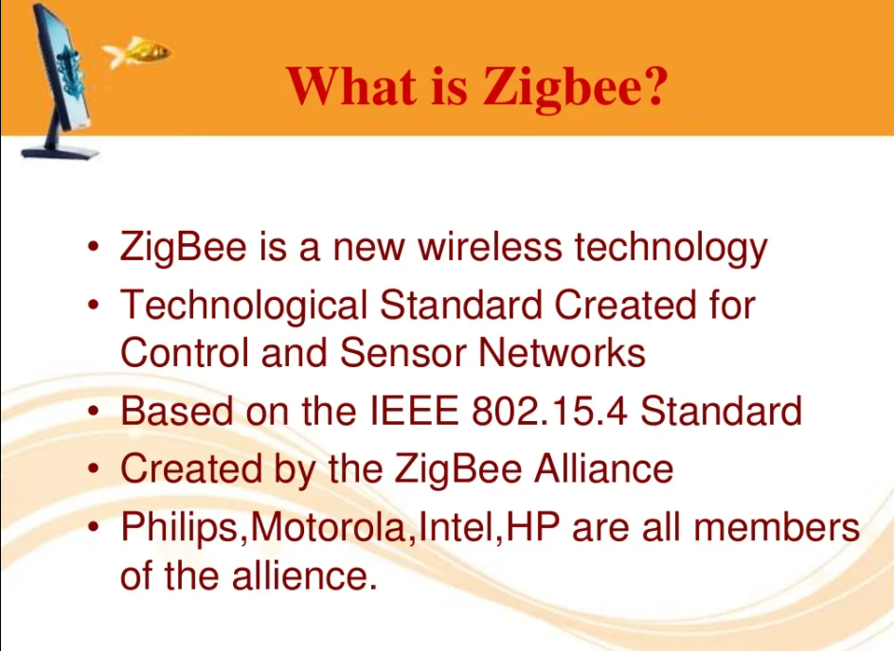

Slide 19
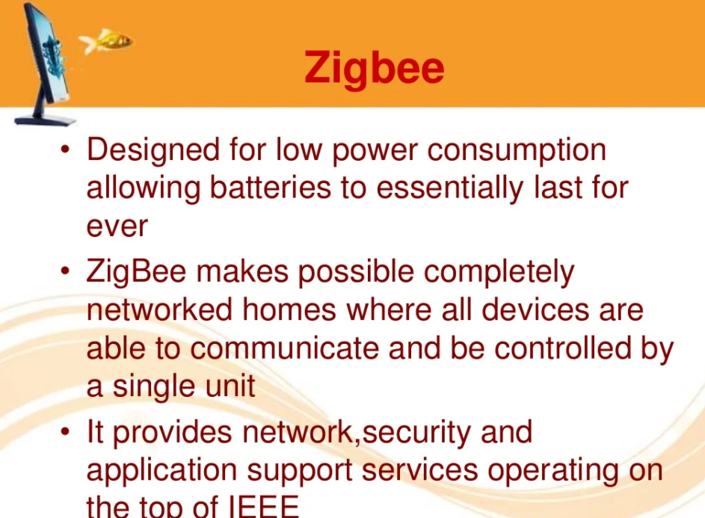

Slide 20
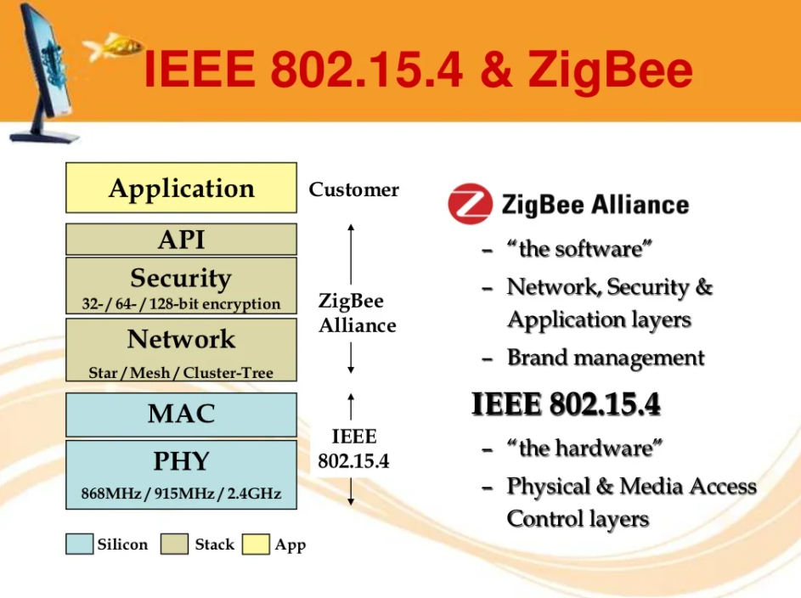

Slide 21
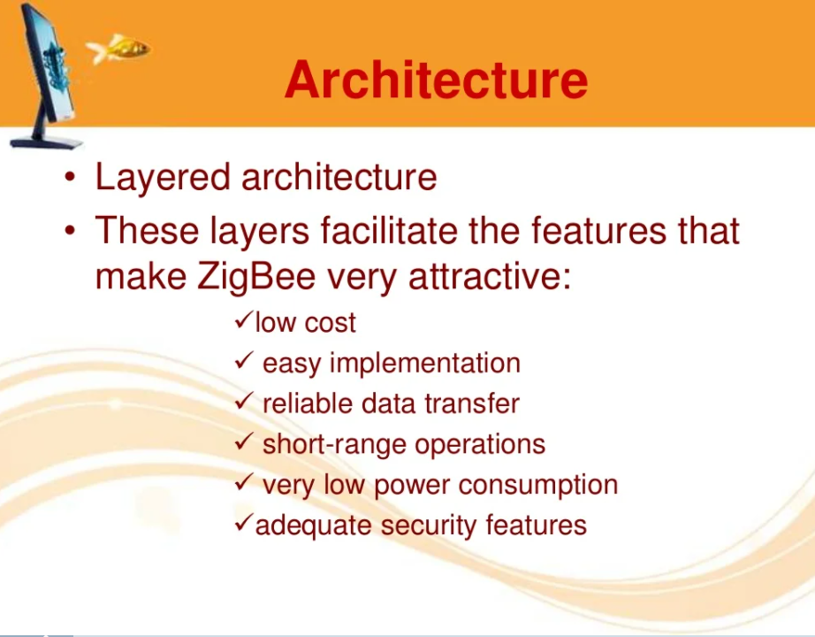

Slide 22
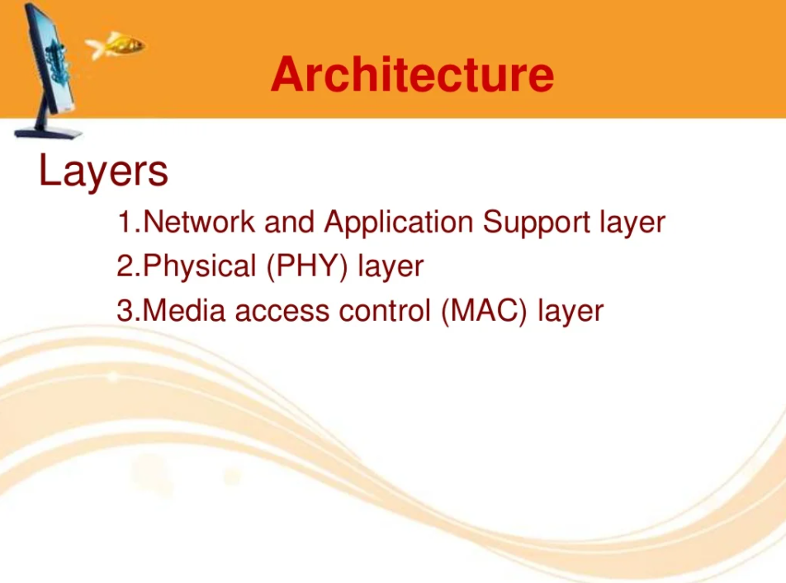

Slide 23
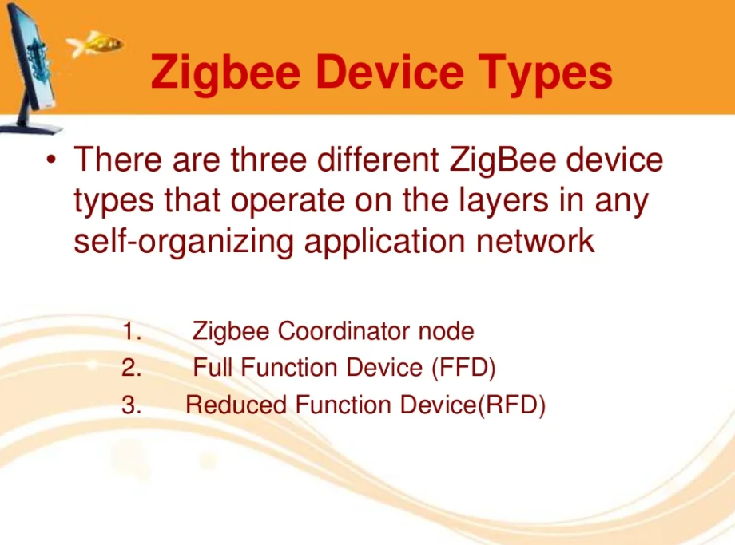

Slide 24
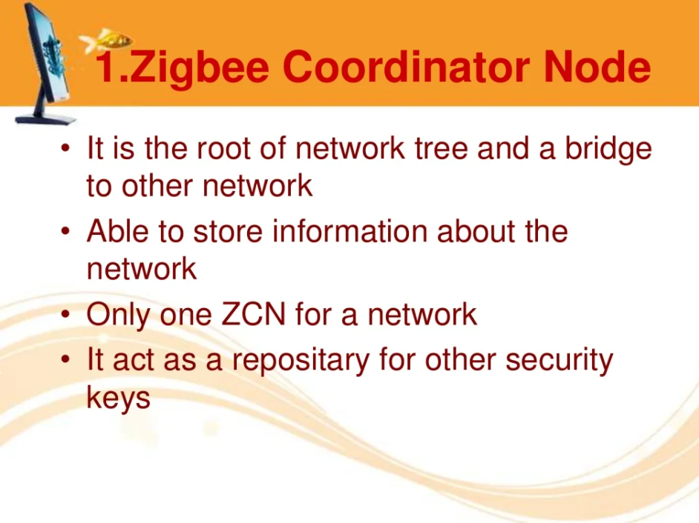

Slide 25
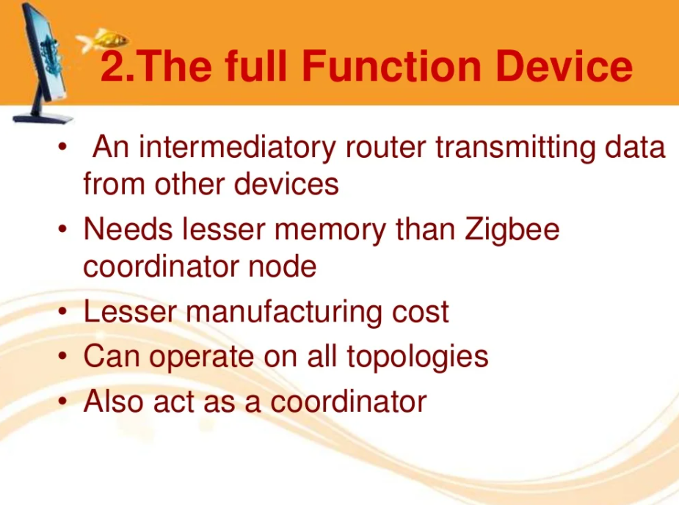

Slide 26
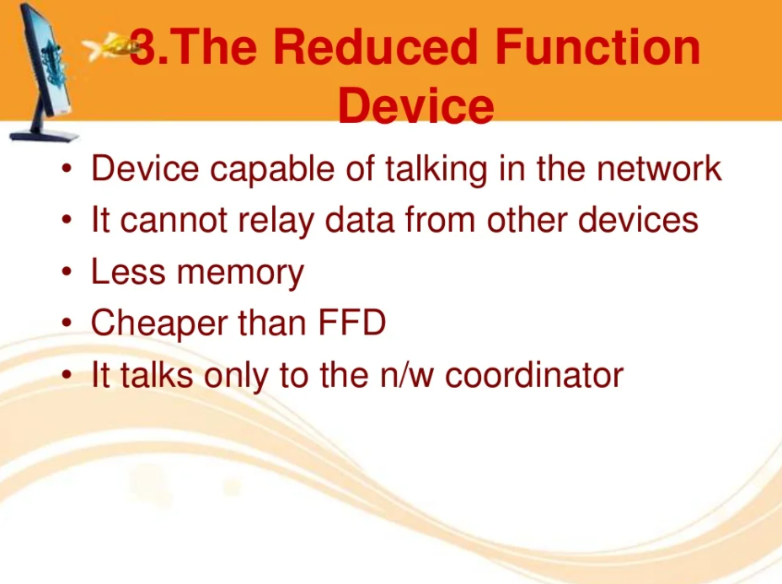

Slide 27
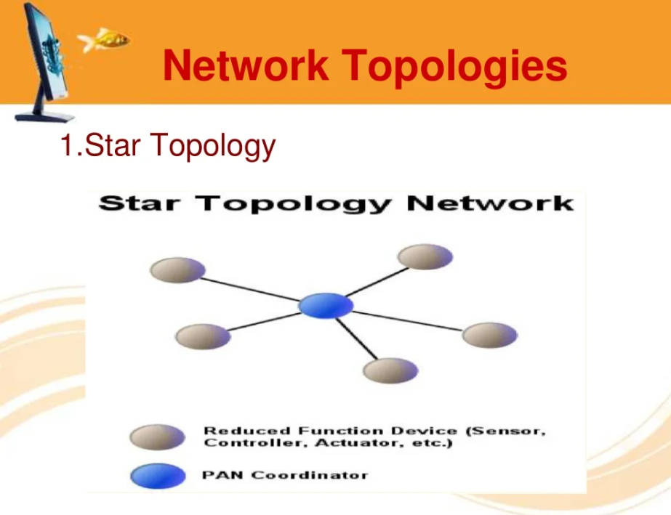

Slide 28
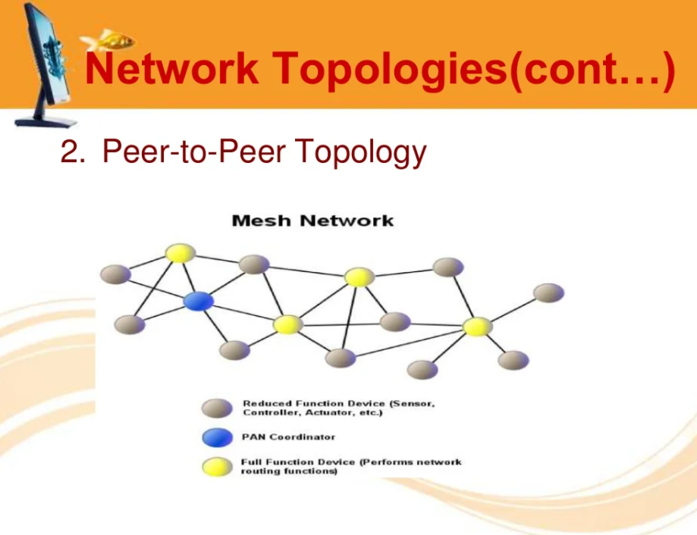

Slide 29
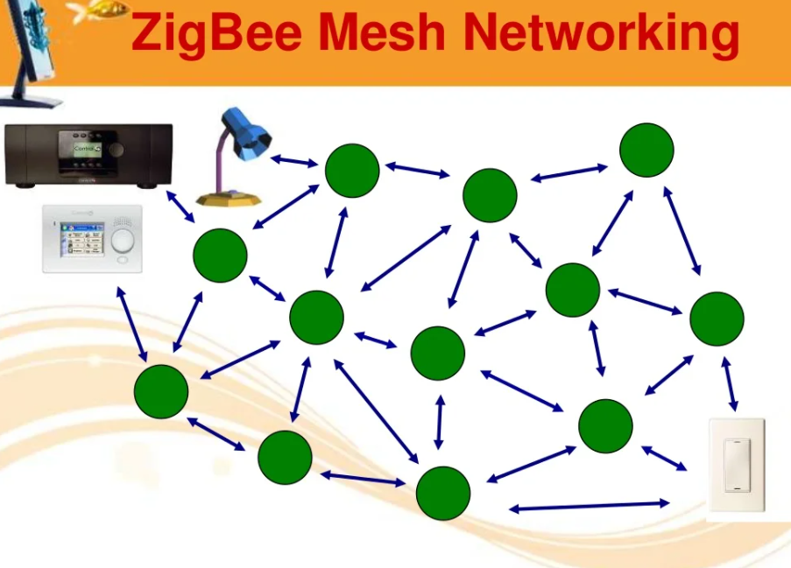

Slide 30
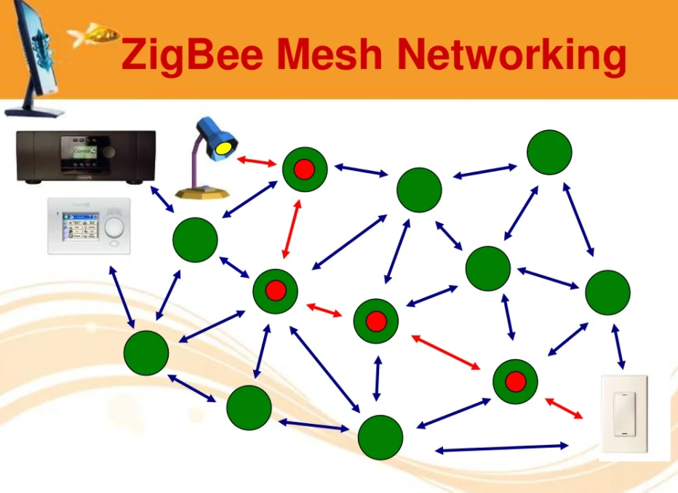

Slide 31
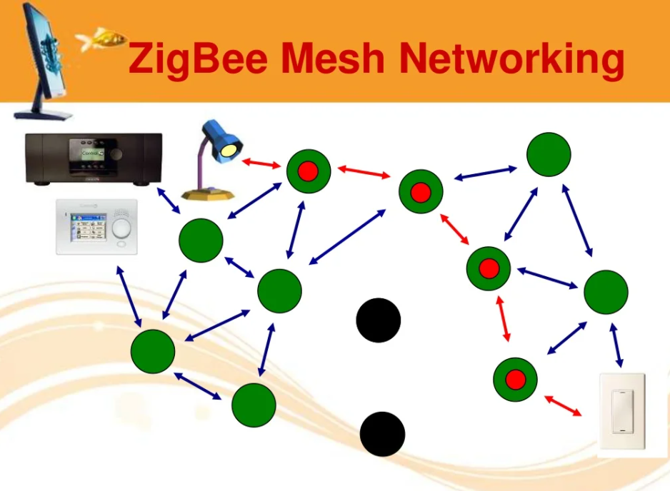

Slide 32
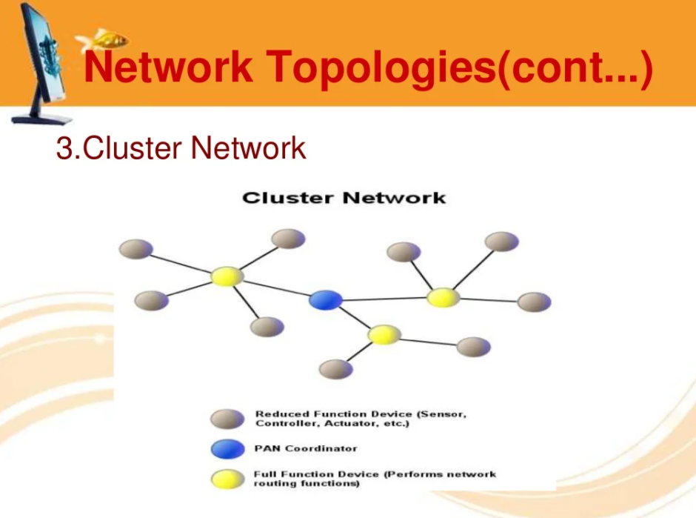

Slide 33
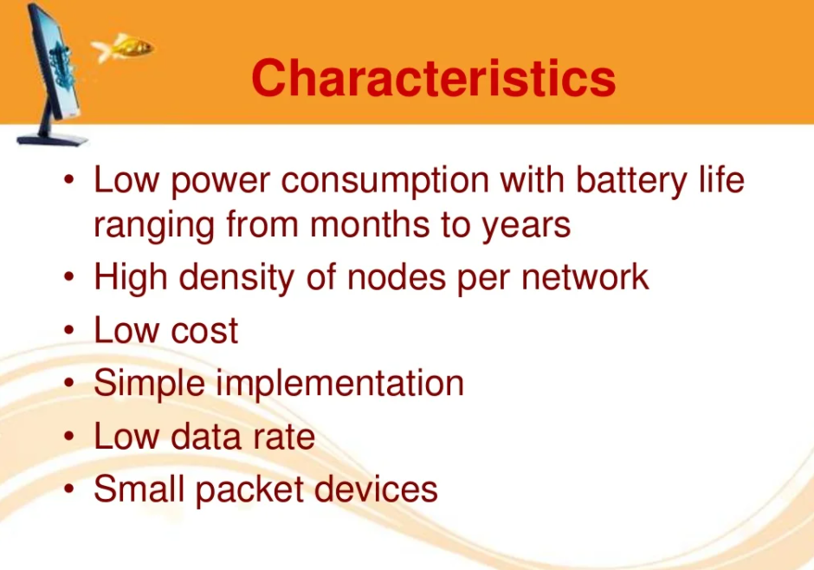

Slide 34
WI FI

Slide 35
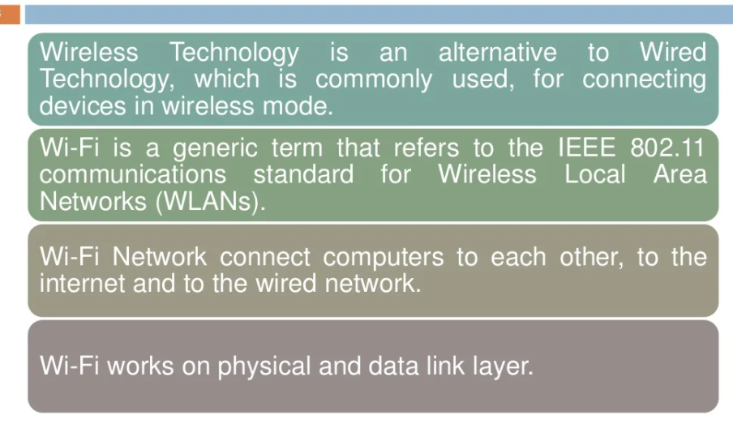

Slide 36
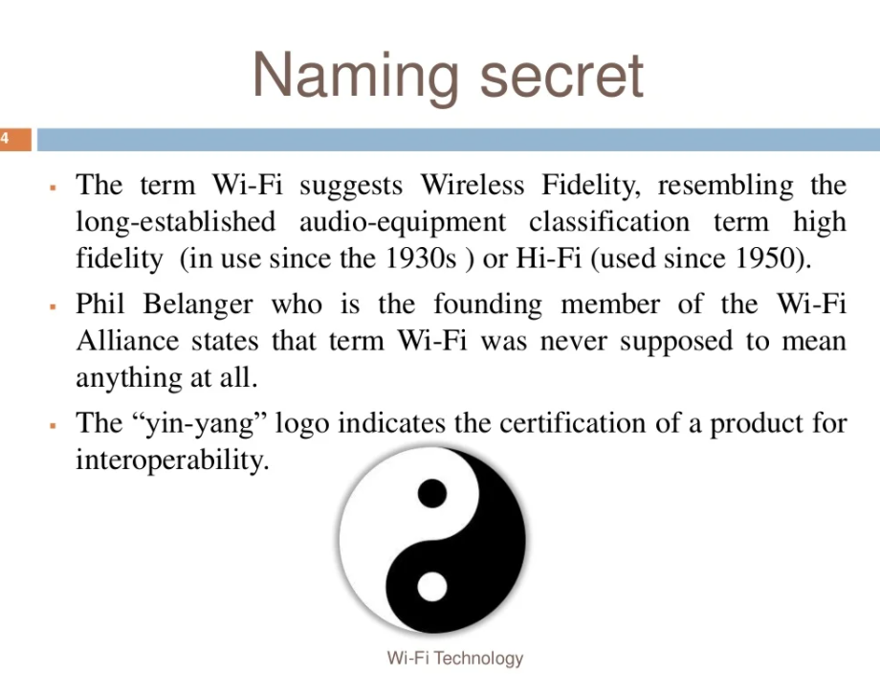

Slide 37
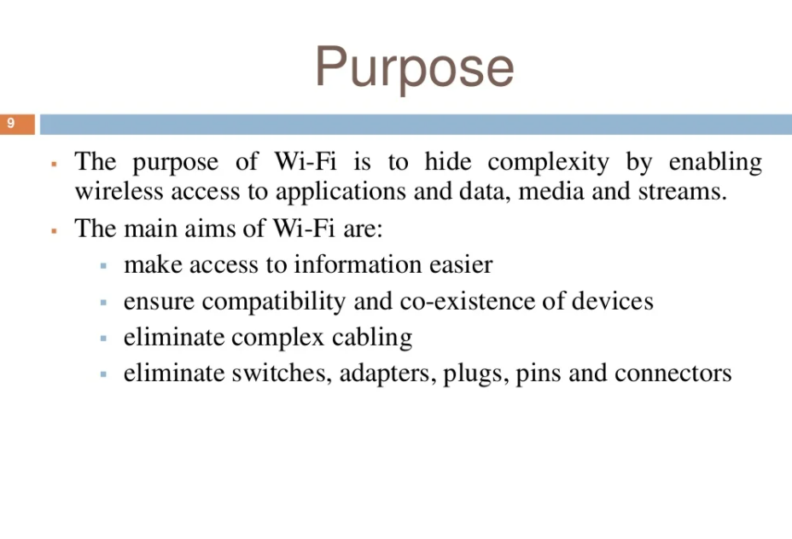

Slide 38
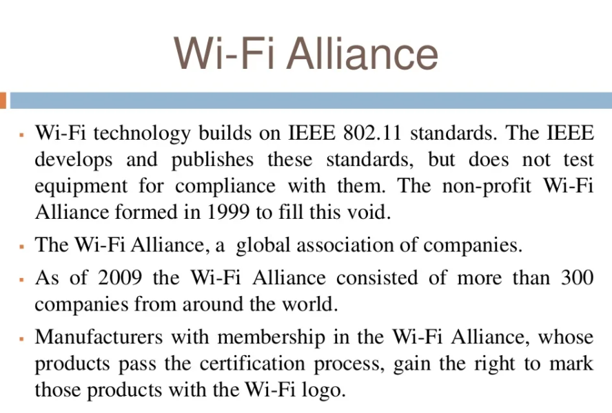

Slide 39
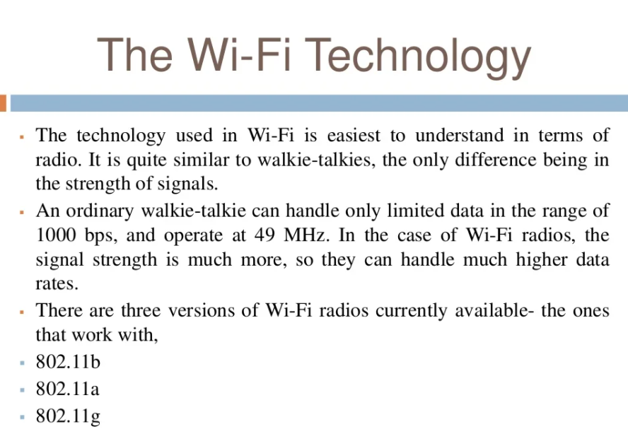

Slide 40
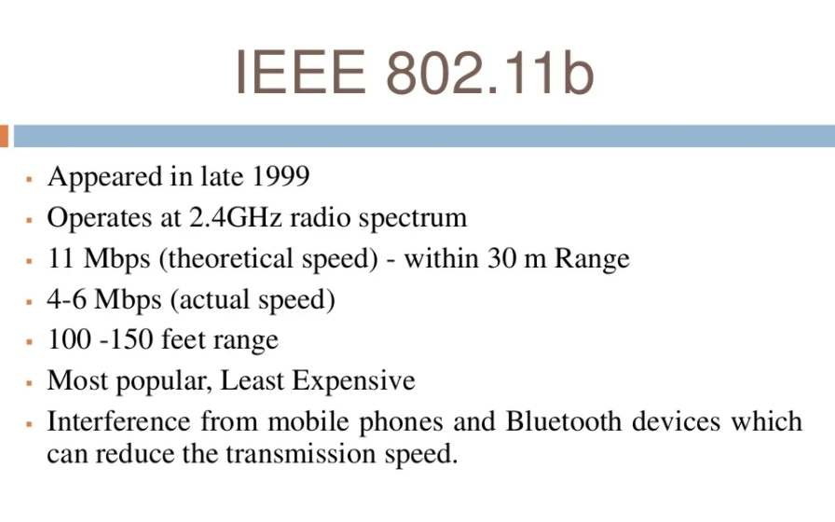

Slide 41
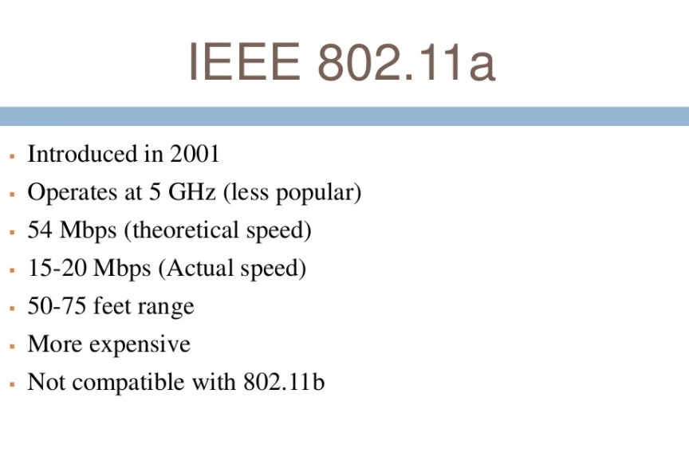

Slide 42
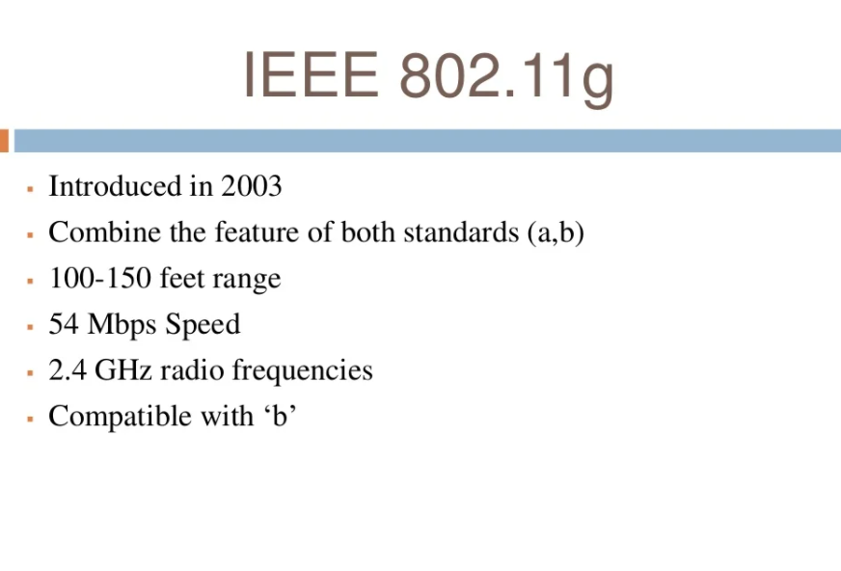

Slide 43
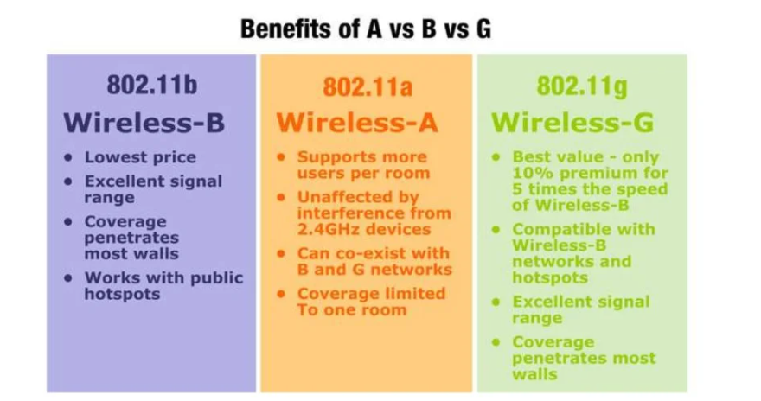

Slide 44
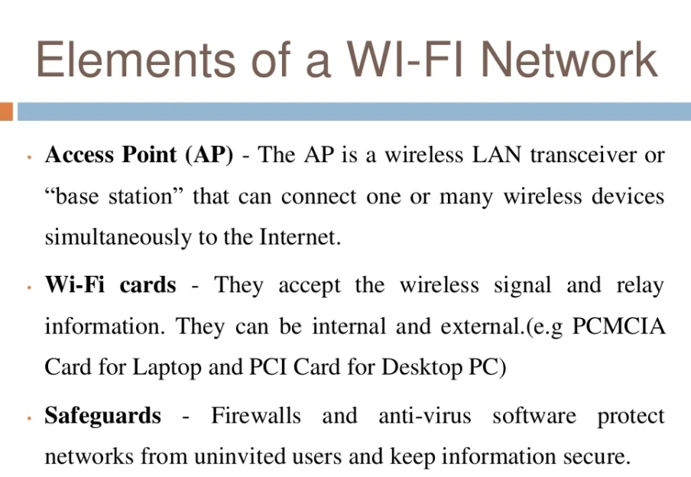

Slide 45
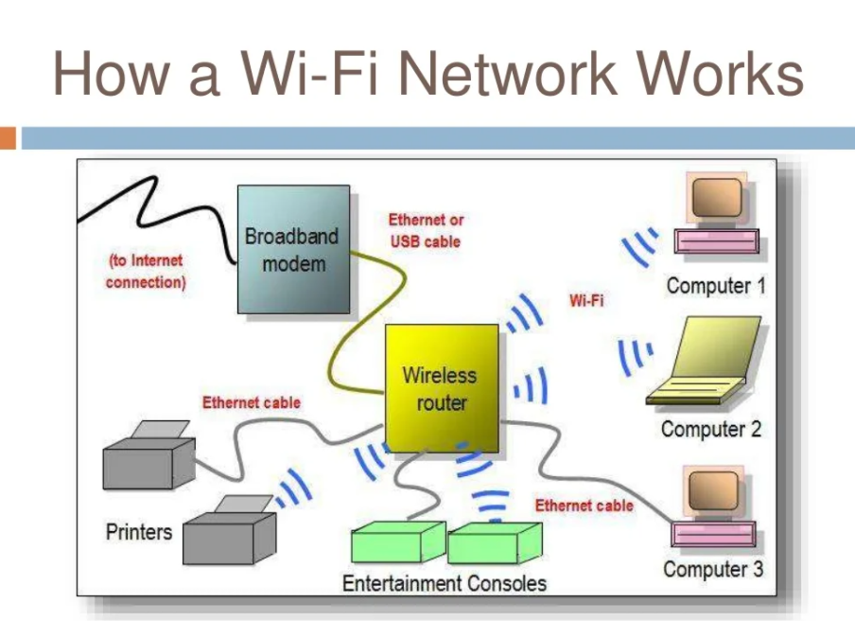

Slide 46
Common Radio Protocols
Radios for indoor applications
Radios for outdoor IoT applications
Design requirements
Long range
Low data rate
Large number of devices
Low energy consumption
Common protocols
GSM/GPRS
LTE (Long term Evolution)
Emerging protocols
Sigfox/LoRA (Long Range)
Narrow band LTE
Backscatter
Design requirements
Short range
High data rate
Small number of devices
Common protocols
Bluetooth/Low Energy
ZigBee
Ant
WiFi
Notes:
https://www.sparkfun.com/products/10268
http://www.directindustry.com/prod/digi-international/zigbee-radio-modules-16022-799537.html
http://labs.beatcraft.com/en/index.php?gadget%20%2F%20ANT%20module
https://www.sparkfun.com/products/10822

Slide 47
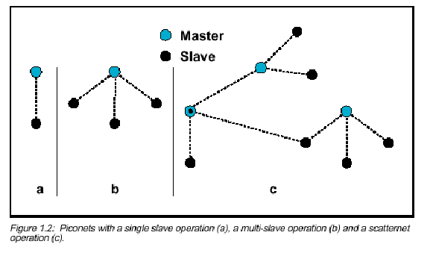
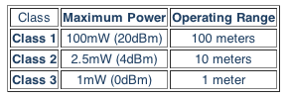
Bluetooth
Radio band: 2.4-2.48 GHz
Average 1 Mbps - Up to 3 Mbps
Supports point-to-point and point-to-multipoint
Creates personal area networks (PANs/Piconets)
Connects up to 8 devices simultaneously
Minimal interference between devices
Devices alter frequencies arbitrarily after packet exchanges -up to 1600 times/second - frequency hopping
3 classes of Bluetooth transmit power
Notes:
http://electronics.howstuffworks.com/bluetooth.htm
http://www.mobileinfo.com/Bluetooth/applic.htm
http://bluetoothinsight.blogspot.com/2008/01/bluetooth-power-classes.html

Slide 48
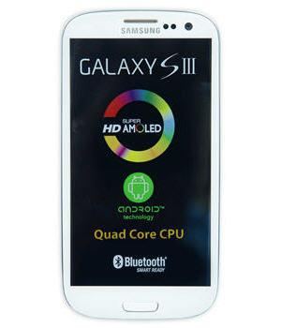
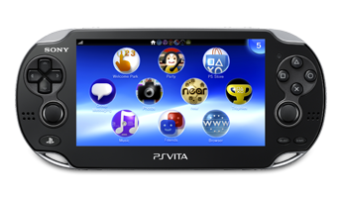
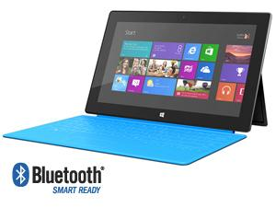
Bluetooth Applications
Wireless communication between devices
Mobile phones, laptops, cameras, gaming controllers, computer peripherals, etc
Short range sensor transmission
Share multimedia - pictures, video, music
A2DP - Advanced Audio Distribution Profile
Stream audio wirelessly
Notes:
http://www.bluetooth.com/Pages/Bluetooth-Home.aspx

Slide 49
Bluetooth low energy
From 2001 – 2006 Nokia asked:
How do we design a radio that can transmit short bursts of data for months or years only being powered by a coin cell battery?
The answer is: Keep the radio asleep mode most of the time!
Advertise on only one of three channels
Transmit quickly at 1 Mbit/s
Make the minimum time to send data only 3 msec
Make a very predictable time when the device accepts connections
Limit the max transmit power to 10 mW
However, don’t sacrifice security: AES 128-bit

Slide 50
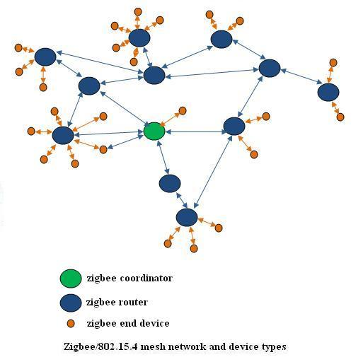
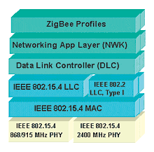
Zigbee/802.15.4
Zigbee is built on top of 802.15.4
Radio bands: 868MHz in Europe, 915MHz in US and Australia. 2.4GHz else worldwide.
Low data-rate - 250 kbps, low power – Up to 1000 days
Transmits over longer distances through mesh networks

Slide 51
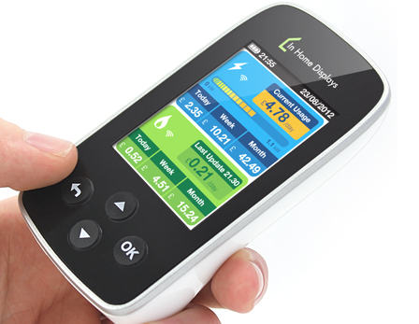
Why ZigBee?
Low Power, Cost, and Size
Straightforward configuration
Good support and documentation
Lots of products already on the market
Mesh Networking
Lends itself well to many different applications
Very low wakeup time
30mS (Zigbee) vs. up to 3S (Bluetooth)

Slide 52
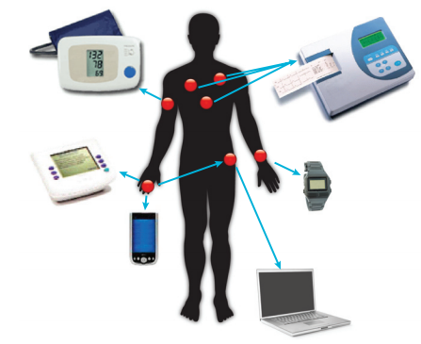

Zigbee/802.15.4 Applications
Wireless environmental sensors
Temperature, pressure, sound, luminous intensity
Medical devices
Glucose meters, heart monitors
Household automation
Security/temperature controllers
Smoke/motion detectors

Slide 53
6LowPAN
6LoWPAN stands for IPv6 over Low-power Wireless Personal Area Networks.
It is a standard protocol for realizing IPv6 communication on wireless networks composed of low-power wireless modules.
6LoWPAN specification contains packet compression and other optimization mechanisms to enable the efficient transmission of IPv6 packets on a network with limited power resources and reliability, which makes efficient IPv6 communication over low-power wireless networks possible.
Notes:
http://compnetworking.about.com/od/wirelessfaqs/f/5ghz-gear.htm
http://compnetworking.about.com/cs/wireless80211/a/aa80211standard.htm
2.4GHz band, cheaper, a little lower speed
5GHz band, expensive but better performance due to less interference

Slide 54
6LowPAN
Various low-power wireless networks have been proposed and implemented before 6LoWPAN, but currently, 6LoWPAN is regarded as one of the preferred protocols to realize the Internet of Things (IoT).
This is because 6LoWPAN communication based on IPv6 allows once closed low-power wireless networks to interface with the global network, the Internet, and implement more advanced intelligent services that were not possible in the past.
Notes:
http://compnetworking.about.com/od/wirelessfaqs/f/5ghz-gear.htm
http://compnetworking.about.com/cs/wireless80211/a/aa80211standard.htm
2.4GHz band, cheaper, a little lower speed
5GHz band, expensive but better performance due to less interference

Slide 55
6LowPAN
Let us take the future smart house architecture.
Optimized control of a smart house requires the information to be collected from various sensors. The control system consolidates the information to recognize the real-world context then gives appropriate optimized feedback to the real-world environment using actuators.
Management of a smart house by executing control logic on the reliable cloud server infrastructure is cost-effective from the viewpoint of high scalability, usability, and low maintenance cost. To realize such a control framework, 6LoWPAN‘s conformance to the Internet protocol plays an important role.
Notes:
http://compnetworking.about.com/od/wirelessfaqs/f/5ghz-gear.htm
http://compnetworking.about.com/cs/wireless80211/a/aa80211standard.htm
2.4GHz band, cheaper, a little lower speed
5GHz band, expensive but better performance due to less interference

Slide 56


Notes:
http://www.atmel.com/microsite/AT86RF232/default.aspx

Slide 57
Protocol Comparisons
 | Bluetooth | Zigbee/802.15.4 | WiFi
Speed | Moderate | Low | High
Range | Moderate - High | High | High
Power Consumption | Low - Moderate | Low | High

